Slide 1
Announcements
Only day labs (3:30 p.m.) left for the semester
All grading should be caught up on by now
Let me know if you have any questions
A little late since we are done with the night labs… but please make sure you are writing your lab using what you actually observe - i.e. not planets that are not even above the horizon

Slide 2
Variable Stars
RR Lyraes, Cepheids, and Binaries, oh my

Slide 3
Variable Stars
Variable stars are stars whose brightness varies cyclically over time
Technically, all stars change as they age
But today we are interested in the ones that go through a cycle

Slide 4
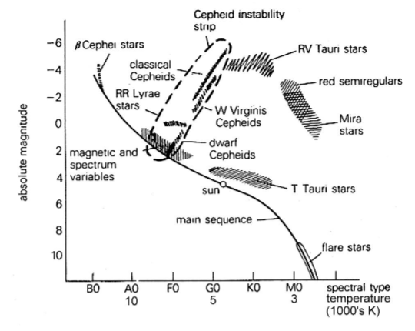
Common Types
RR Lyrae Stars:
Small (relatively - still several times bigger than the Sun)
Change in brightness due to the size changing up and down from internal instability
All have an average absolute magnitude of around 0.5
Period is less than a day
HR Diagram (next week’s lab) for Variable Stars
HR Diagram: A graph of stars with magnitude (brightness) on the y-axis and temperature (color) on the x-axis

Slide 5
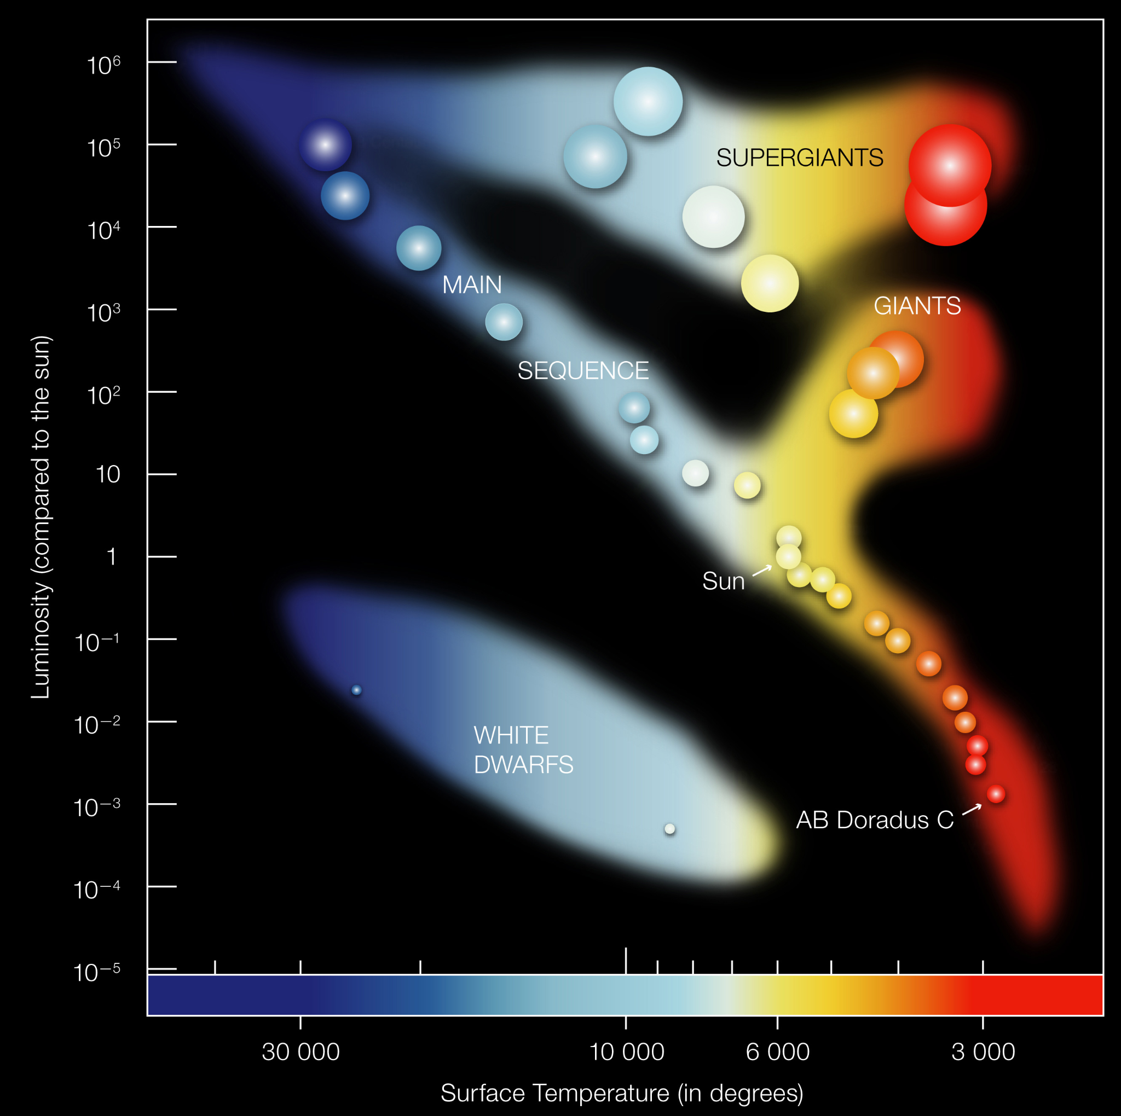

Slide 6
Common Types Cont.
Cepheid Variable Stars:
Big (10s to 100s of times more than the Sun)
Change in brightness due to the size changing up and down from internal instability (same mechanism as RR Lyrae)
Absolute Magnitude varies based on size
Period can be 1 day to around 100 days
Importantly: Their period and luminosity (absolute magnitude) have a direct relationship
HR Diagram (next week’s lab) for Variable Stars
HR Diagram: A graph of stars with magnitude (brightness) on the y-axis and temperature (color) on the x-axis

Slide 7

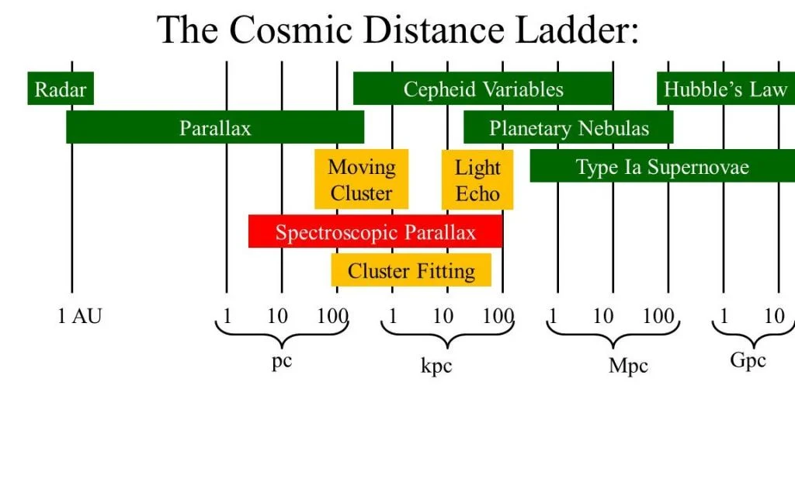
Tangent about the Harvard “Computers”
A group of women hired to analyze and catalog astronomical data/images from the observatory in the late 1800s and early 1900s
They are arguably responsible for much of modern astronomy
Including a stellar classification system that we still use (a modified version of) today (Annie Jump Cannon, 1922)
O,B,A,F,G,K,M
And (relevant to this lab) the Cepheid period-luminosity relationship (Henrietta Leavitt, 1908)
This was the first way we had to determine the distance to astronomical objects other than parallax
It further influenced the creation of Hubble’s Law (last lab of semester)
For more: look into the play Silent Sky by Lauren Gunderson

Slide 8
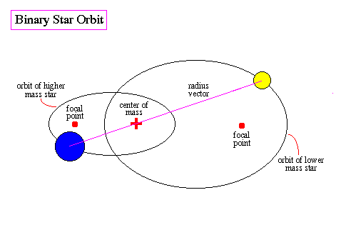
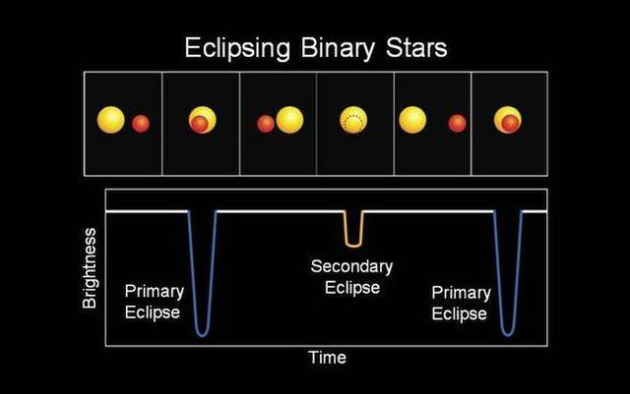
Common Types Cont.
Eclipsing Binaries:
Any size
2 star binary (or more!) system
Brightness changes due as the stars pass in front of each other (from our perspective) blocking some of the light
This is similar to one of the most effective ways of finding exoplanets (planets around other stars) (see exoplanets lab in AST 111)
In fact, one of the hardest parts of finding exoplanets is figuring out if you are looking at a star with a planet, a variable star, or even both at once (or something else i.e. sunspots)

Slide 9
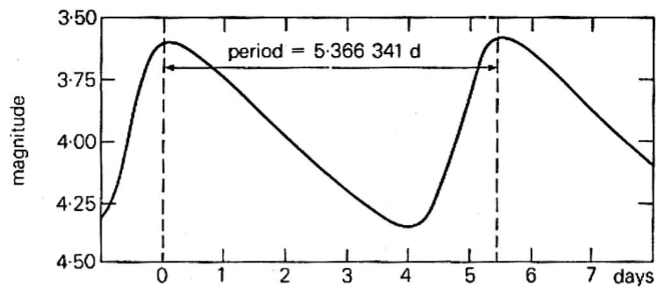
What is a “Light Curve” and How to Read Them
A curve in this context is a mathy word for a shape on a graph
In this case, showing brightness/luminosity/magnitude on the y-axis and time on the x-axis
So you can see how the star changes over time
To read them, look for a cycle - two identical points on the graph (usually the brightest or dimmest points, depending on the graph)
The time between these points is the “period” or how long one cycle lasts

Slide 10
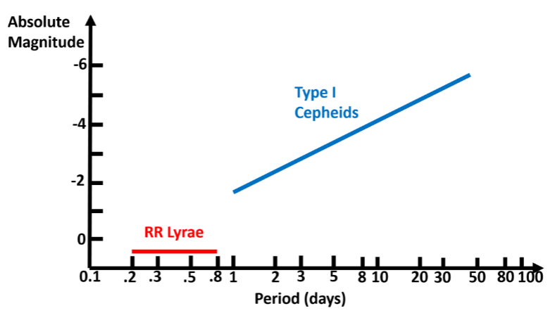
The Cepheid Period-Luminosity Relationship
This graph is similar to a light curve, but the x-axis is the period instead of total time
To use it:
Get the period from the light curve
Find it on the x-axis here
What y-value does that spot have on the line
That is the absolute magnitude
This graph is also in your lab script and is very important for completing this lab

Slide 11


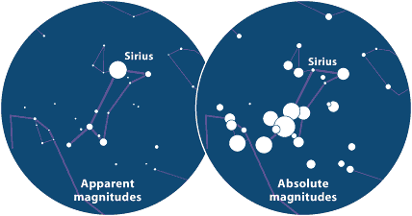
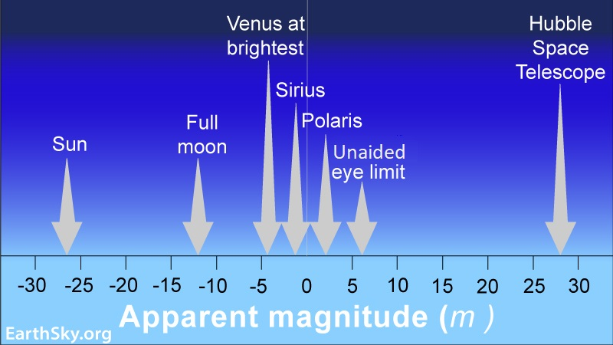
Math and Magnitude Reminders
Magnitude is a reversed scale - smaller numbers (including negative) are brighter than bigger numbers
The Distance Modulus:
F Solve for distance, d:

Slide 12
Today
Do questions 1-3
Fill out the table using the light curves found on the last 3 pages
Not every cell will be used
Look at your answers to question 1 to determine which to use for each light curve
Then finish the remaining questions (4-12)
Extra Credit Opportunity:
Go to “zooniverse.org”
Go to “Projects” and search “SuperWASP”
Make at least 15 classifications
Attach to your lab (or email me):
Screenshot of your profile stats page showing the number of classifications
A paragraph description of what you thought of the project (i.e. was it interesting, did it help your understanding of variable stars, etc)

